Slide 1
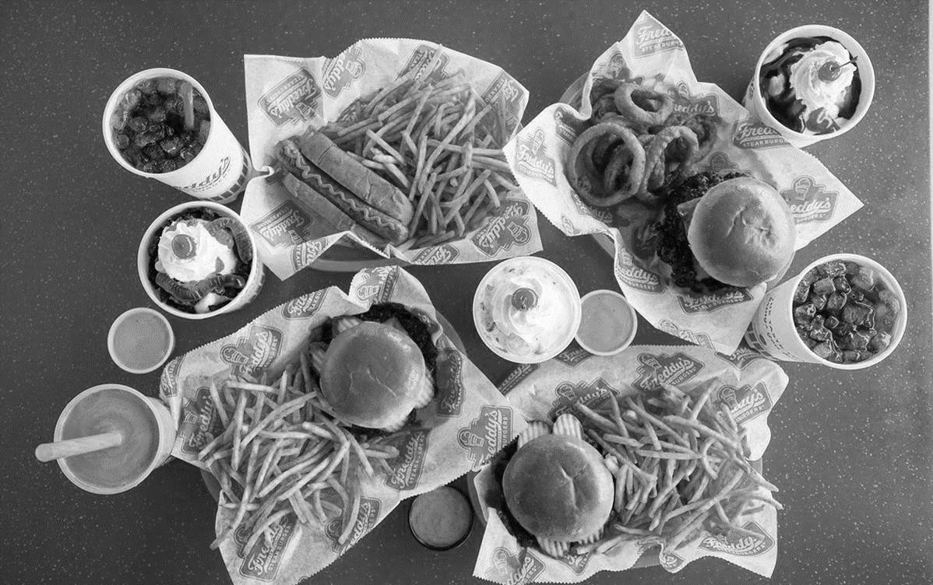
LEADERSHIP TRAINING
MLY DEVELOPMENT WORKBOOK
Coldline Start

Slide 2
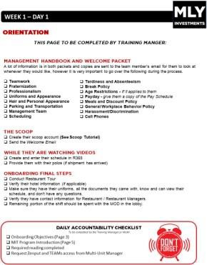
INSTRUCTIONS FOR BINDER ASSEMBLY
The first page of the Binder should be the MLY LEADERSHIP TRAINING COVER PAGE followed by all subsequent pages up the POSTIONAL TRAINING COVER
PAGE. The FFC MANAGEMENT MIT WORKBOOK should be fully inserted
BEFORE
the POSITIONAL TRAINING COVER PAGE but the LEADERSHIP TRAINING
AFTER
PAGE and its subsequent pages. See diagram below.
Start here | and insert
 | until here.
all pages
Insert entire FFC Workbook next. After the FFC Workbook Insert the rest of the MLY Workbook starting at the Positional Training Cover Page
FFC MANAGEMENT MIT WORKBOOK
For questions and support on this binder, please contact your Multi-Unit Manager
or Lay Flowers.

Slide 3
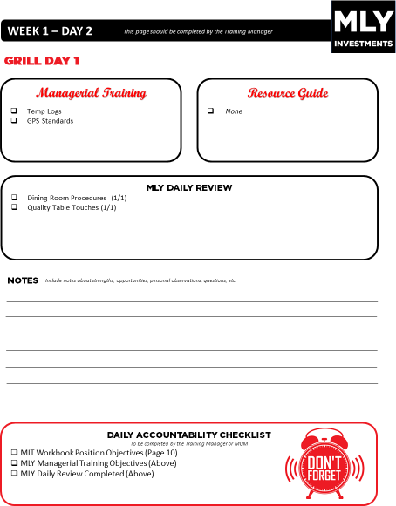
INSTRUCTIONS FOR USE
MLY DEVELOPMENT WORKBOOK
The following workbook is intended to be a supplemental addition to the FFC MIT WORKBOOK. Each day there will be an MLY Workbook page to complete in addition the material found in the FFC Workbook. For example, on Grill Day 1 in the FFC WORKBOOK, there is also a GRILL DAY 1 in the MLY WORKBOOK. Ensuring completion of both books daily will keep your MIT on the best path to successfully completing the MLY Leadership Development Program.
Please note that you will complete ALL pages in both books with the exception of
the TRAINING COMPLETION SIGNOFF. Please use the MLY VERSION, NOT THE
FFC VERSION.
This day matches the day title in the FFC MIT WORKBOOK.
These are additional MLY Objectives to complete for the day.
Completing this checkbox will ensure you’ve properly completed the FFC MIT Workbook Objectives and the MLY Objectives

Slide 4
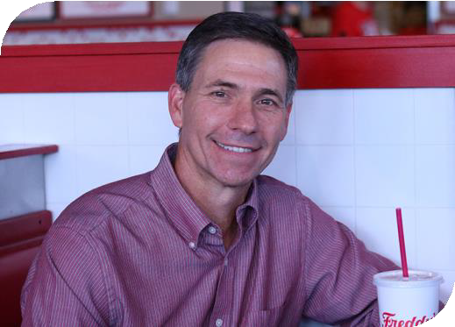
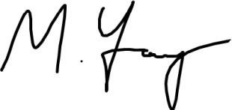
WELCOME
Welcome
Welcome to Freddy’s!
On behalf of the entire Freddy’s Family in Iowa, I would like to welcome you to MLY Investments, LLC. Your dynamic personality, professionalism, and commitment to serving our Guests is why you are now part of our Freddy’s Family. We are confident that you will help us achieve our Vision of becoming a “cult-favorite” in the communities where we have locations.
In our organization, our people are the most important assets we have, and we back up that claim with dedication to providing the best training experience in the industry. We wholeheartedly believe that cultivating the most developed managers in the nation is directly correlated with our achievements. In short, your new role as a leader at Freddy’s is important to us and we want you to have an excellent experience while you learn the Freddy’s Way. Your training team and fellow leaders want to set you up for success and are eager to begin working with you!
The legacy of our company and its continued accomplishments makes us one of the most exciting and fastest-growing brands in our industry. This franchise is known for high-powered growth, built from a foundation of incredible management teams. For years, we have made business decisions necessary to ensure our success. The most recent decision was hiring you, and we are certain we made the right choice.
Once again, welcome to the Freddy’s Family, and best wishes to you during your new employment and training. We hope through our company, we will reach new heights together in the journey ahead!
Mike Young
MLY Investments, LLC.

Slide 5
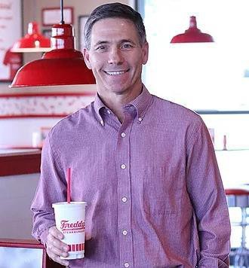
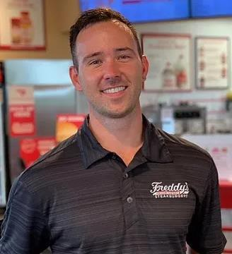
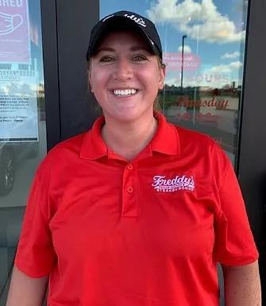
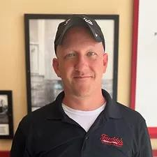
MLY LEADERSHIP TEAM
Mike Young | Operating Partner
Phone: 319-409-6040
Email: mike.young@mlyinvest.com
Tenure: 8 years
Steven Young | Director of Operations
Phone: 319-929-6573
Email: steven.young@mlyinvest.com
Tenure: 8 years
Alison Fuller | Multi-Unit Manager
Phone: 309-373-1114
Email: alison.fuller@mlyinvest.com
Tenure: 5 years
Locations: West Davenport, Dubuque, Waterloo, East Peoria, and East Davenport
Jason Mochal | Multi-Unit Manager
Phone: 319-677-5646
Email: jason.mochal@mlyinvest.com Tenure: 5 years
Locations: Cedar Rapids (Blairs Ferry), Coralville, Ames, Cedar Rapids (Westdale), and Iowa City,
and Grimes

Slide 6
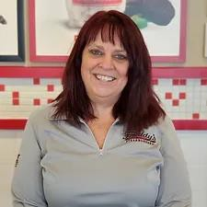
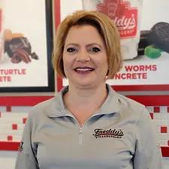
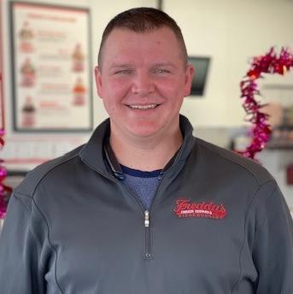
MLY ADMINISTRATIVE TEAM
Phone: 319-409-6040, Option 2
Email: Kellie.Jacobson@mlyinvest.com
Tenure: 6 Years
When to Contact:
Payroll Questions
Paylocity Password Troubleshooting
Invoice Questions
Hotel Requests
Submitting MUM approved Budgets
Phone: 319-409-6040, Option 1 Email: Theresa.jones@mlyinvest.com Tenure: 4 Years
When to Contact:
Recruiting Questions
Marketing Questions
Office Express Troubleshooting
Background Checks
Any HR related questions
Injuries
Phone: 515-981-6303
Email: jsimpson@paneraiowa.com
When to Contact:
Facility Maintenance Questions
UpKeep Support
Preventative Maintenance Questions

Slide 7
MLY TRAINING COMPLETION SIGN-OFF | New Hire
Week 1 | 1 |  | ONBOARDING | Welcome %
 |  |  | Dining Room
 | 2 | 2/2/22 | Cashier 1 | Food Safety % | Jason Mochal
 |  |  | Closing
 | 3 |  | Cashier 2
 |  |  | Closing
 | 4 |  | Cashier 3 | Cashier %
 |  |  | Mid
 | 5 |  | Custard 1
 |  |  | Open
Week 2 | 6 |  | Custard 2 | Custard %
 |  |  | Close
 | 7 |  | Custard 3 / D.R. | Dining Room %
 |  |  | Close
 | 8 |  | Drive-Thru 1 | Drive-Thru %
 |  |  | Mid
 | 9 |  | Grill 1
 |  |  | Open
 | 10 |  | Grill 2 | Grill %
 |  |  | Open
Week 3 | 11 |  | Make 1
 |  |  | Close
 | 12 |  | Make 2 | Make %
 |  |  | Close
 | 13 |  | Fry 1 | Fry %
 |  |  | Mid
 | 14 |  | Expo 1
 |  |  | Open
 | 15 |  | Expo 2 | Expo %
 |  |  | Open
Week 4 | 16 |  | ColdLine MOD
 |  |  | Close
 | 17 |  | ColdLine MOD
 |  |  | Close
 | 18 |  | ColdLine MOD
 |  |  | Mid
 | 19 |  | ColdLine MOD
 |  |  | Open
 | 20 |  | ColdLine MOD
 |  |  | Open
Week 5 | 21 |  | HotLine MOD
 |  |  | Close
 | 22 |  | HotLine MOD
 |  |  | Close
 | 23 |  | HotLine MOD
 |  |  | Mid
 | 24 |  | HotLine MOD
 |  |  | Open
 | 25 |  | HotLine MOD | MGMT %
 |  |  | Open
SS | 26 |  | ServSafe Exam
 |  |  | Open

Slide 8
WEEK 1 – DAY 1
Introduce yourself and get to know the MIT over a beverage.
Enter MIT into Brink POS. Ask for the last 4 of their social. Staff – Employees – New Employee.
Add MIT into R365 (See R365 Tutorial)
Have the MIT check their email / text for their temporary password to login to their account.
Go through the R365 app with them explaining the following
Dashboard Page
The importance of announcements and where to find them
How to view their schedule putting emphasis on that our weeks are Thurs-Wed not Mon-Sun.
Show them how to see the restaurant schedule so they can see everyone scheduled that day.
Show them how to update their availability.
Show them how to request time off. When showing them how to request off make sure to explain if they only need part of the day off, they can do that and don't only need to take the whole day off. You can also submit a practice RO or a real one if they have something coming up.
Use Onboarding Packet 2023
Have the MIT open their email to get their Initial Paylocity Password.
The company code is 11256
Their username is the first 2 letters of their first name then their last name. Example: John Doe would be jodoe. If someone else already has that username Theresa will tell you what the different one will be.
Next fill out the I-9 Verification form.
Enter Direct Deposit Information.
Emergency Contact Information.
Enter Home Contact Information.
Complete Tax Forms.
Complete ALL policy Signatures.
They will need their 2 forms of ID

Slide 9
WEEK 1 – DAY 1
A lot of information is in both packets and copies are sent to the team member’s email for them to look at whenever they would like, however it is very important to go over the following during the process.
Teamwork
Smart Start Card
Fraternization
Professionalism
Uniforms and Appearance
Hair and Personal Appearance
Parking and Transportation
Management Team
Scheduling
Counterfeit Money Procedures
Force for Good - Fundraising
Tardiness and Absenteeism
Break Policy
Smoking Policy
Age Restrictions - If it applies to them
Payday - give them a copy of the Pay Schedule
Meals and Discount Policy
General Workplace Behavior Policy
Harassment/Discrimination
Cell Phones
Scam Call Procedures
Create their scoop account (See Scoop Tutorial)
Send the Welcome Email
Create and enter their schedule in R365
Provide them with their polos (if shipment has arrived)
Create MIT a personalized Freddy’s email. Example: John Doe would be Jdoe.ffcsb@gmail.com
Send Systems request Google Form for managerial access to R365, Teams, Brink Etc. (use email created from above)
Conduct Restaurant Tour
Verify their hotel information (if applicable)
Train the MIT on the MLY Hotel Request Form
Make sure they have their uniforms, all the documents they came with, know and can view their schedule, and don't have any questions.
Verify they have contact information for Restaurant / Restaurant Managers.
The remaining portion of the shift should be spent with the MOD in the lobby.
To be completed by the Training Manager or MUM
Onboarding Objectives (Page 3)
MIT Program Introduction (Page 5)
Required reading completed
Request Zenput and TEAMs access from Multi-Unit Manager

Slide 10
POSITIONAL TRAINING
MLY DEVELOPMENT WORKBOOK
The following material is aligned with the Freddy’s USA positional training program of the MIT Workbook. Please use all subsequent pages with pages 9 through 52 of the MIT Workbook.

Slide 11
SMART START CARD
WEEK 1 – DAY 1
Start every meeting by Reminding & Reaffirming the Team of Our Commitment at MLY Investments.
We Do NOT Tolerate:
Sexual Harassment / Discrimination / Bad Attitudes / Jerks / Drama / Gossip / Alcohol, Drug or Other Substance Abuse / Misappropriation of Company Funds or Property
If you SEE it (or Hear about it)…
STOP IT – FIX IT – REPORT IT
Full Disclosure = Bad News First + No Surprises
(It could have legal implications, and it does have moral implications)
SMART START TIPS
Keep the message fresh. Don’t let it be “pencil-whipped”. The message should
have impact every time it is delivered.
Unprofessional or Inappropriate Behavior includes (but is not limited to):
Profanity; Jokes w/ Bad Taste
Gossip; Rumor-Spreading
Compromising Standards
Dishonesty, Lack of Integrity
Intimate Relations within Your Team
Improper Dress, Etiquette or Appearance
3.
“Stop It”
means if you hear about an “incident”, investigate before judging; then
4.
be prompt, thorough and decisive in stopping any ongoing violation.
“Fix It”
means coach, teach and reprimand so the incident won’t ever occur again
5.
– here or anywhere in the organization.
“Report It”
means you must document your response to these problems to protect
yourself and ourselves from legal liability.
Document ALL you hear, see and say.

Slide 12
SAMPLE PAGE
For reference on how to utilize the training material
Training
This box will contain any new tasks that the MIT will be learning that day and should be taught by the GM or the Training Manager
This box will reference any training guides and tutorials available in the MLY Investments Resource Guide
This box will contain any material that the MIT has already learned on a previous day but still needs to be reviewed to make sure they have a solid understanding of the material. Each review item will have a number after it such as 1/1 or 2/4 which is how many days they will spend reviewing the material.
Include notes about strengths, opportunities, personal observations, questions, etc.
Notes:
To be completed by the Training Manager or MUM
This box will be signed off by the training manager verifying that all required material for the day has been reviewed
Insert after positional training cover page

Slide 13
WEEK 1 – DAY 2
This page should be completed by the Training Manager
Training
Disassemble and Clean Taylor Machine
GPS Standards
None
Dining Room Procedures (1/1)
Quality Table Touches (1/1)
Include notes about strengths, opportunities, personal observations, questions, etc.
Notes:
To be completed by the Training Manager or MUM
MIT Workbook Position Objectives (Page 10)
MLY Managerial Training Objectives (Above)
MLY Daily Review Completed (Above)

Slide 14
WEEK 1 – DAY 2
This page should be completed by the Training Manager

Slide 15
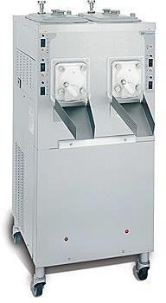
WEEK 1 – DAY 2
This page should be completed by the Training Manager
We disassemble, clean, and reassemble the custard machine nightly to keep the machine clean and in good working order. It is important to note that ONLY a manager can clean the custard machine as the parts range anywhere from $100 - $25,000 to replace. To disassemble the machine, you will first run out the remaining custard. After turning off the Refrigeration and Freeze Switches, fill it with water and let the dashers run for about 30 minutes. After 30 minutes you can hook up the
“elephant” and drain out the water while scrubbing the inside of the hoppers. After the hoppers are clean cover the drain with a towel and remove the bolts to take off the faceplate. Remove the rest of the parts and clean out the barrel. Take all the parts back and wash, rinse, and sanitize them in the 3-compartment sink. They can NOT go through the dish machine. Lightly lube up the black O-rings and reassemble the machine after the parts have been cleaned.
Important things to note:
The custard machine is cleaned nightly ONLY by a manager.
The parts are cleaned in the 3-compartment sink, NEVER in the dishwasher (the high heat will break the parts).
Cover the drain when removing the faceplatebolts.
Clean the black drip trays on the side of the machinenightly.
Lightly lube all black O-rings when reassembling.
NEVER FORGET - turn off Refrigeration and Freeze switches when filling the hoppers with water.

Slide 16
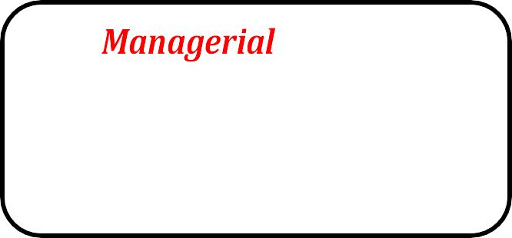
WEEK 1 – DAY 3
This page should be completed by the Training Manager
Training
Daily Drawer Counts
Cash Over / Short Procedures
AM & PM Readiness Evaluations
Zenput Tutorial
Disassemble and Clean Taylor Machine (1/3) – Content found on Day 2
Include notes about strengths, opportunities, personal observations, questions, etc.
Notes:
To be completed by the Training Manager or MUM
MIT Workbook Position Objectives (Page 10)
MLY Managerial Training Objectives (Above)
MLY Daily Review Completed (Above)

Slide 17
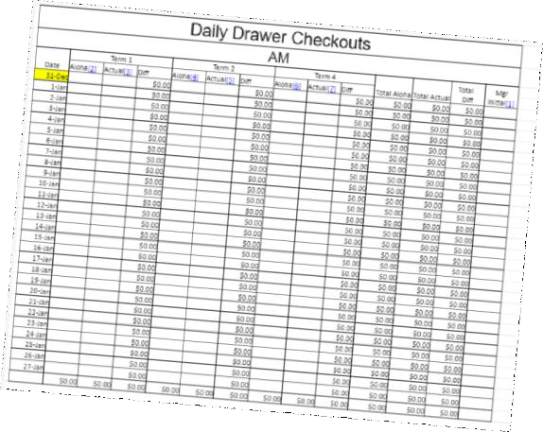
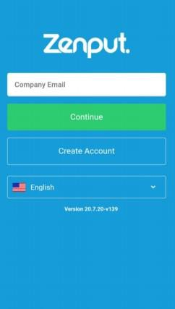
WEEK 1 – DAY 3
This page should be completed by the Training Manager
Daily Drawer Counts are an essential practice to monitor the cash flow of the restaurant and hold team members accountable for any irregularities. We complete these counts at least 3 times a day during the open, at shift change, and at close. It is important that only one team member is assigned to a drawer, and it is changed out and counted before they leave, or another team member begins taking transactions.
Readiness evaluations are a powerful tool used to monitor food safety opportunities in the restaurant along with building awareness of what types of violations occur in our Restaurants. These are completed twice a day, once in the morning right before open and again right before dinner.
Understanding Cash Over / Short procedures is an important step in holding team members accountable should any issues arise. It is important to understand the proper steps in identifying a cash handling issue as well as finding the root cause of it.
MITs should know how to:
Identify a cash issue
Find the cause of the issue
Properly document any cash handling issues
Review footage and investigate potential theft

Slide 18
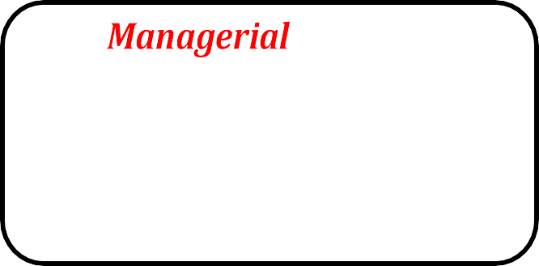
WEEK 1 – DAY 4
This page should be completed by the Training Manager
Training
Domo Report
Teams
Daily Roster
Line up board
Cleaning Calendar Task
Running Custard
Daily roster email
Daily domo email
Daily Drawer Counts (1/5) – Content found on Day 3
Readiness Evaluations (1/4) - Content found on Day 3
Cash over / short procedures (1/1) - Content found on Day 3
Disassemble and Clean Taylor Machine (2/3) – Content found on Day 2
Include notes about strengths, opportunities, personal observations, questions, etc.
Notes:
To be completed by the Training Manager or MUM
MIT Workbook Position Objectives (Page 14)
MLY Managerial Training Objectives (Above)
MLY Daily Review Completed (Above)

Slide 19
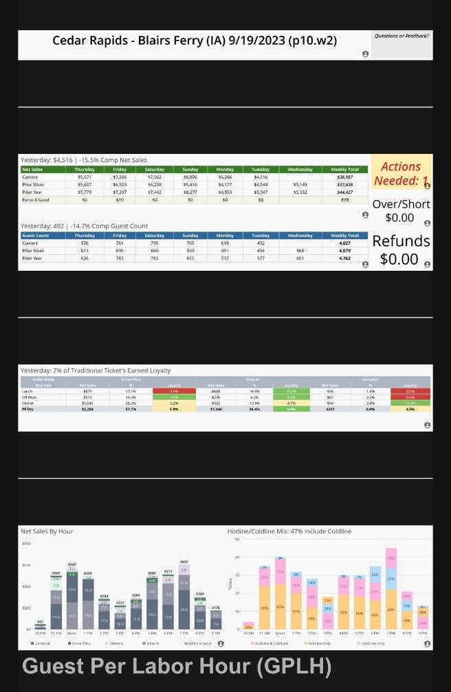
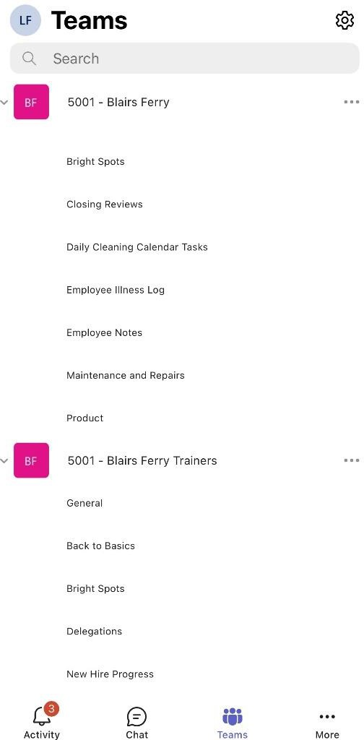
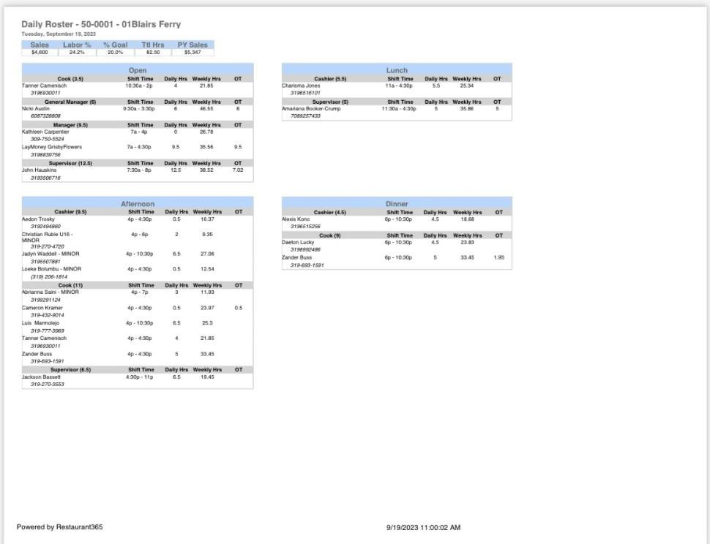
WEEK 1 – DAY 4
This page should be completed by the Training Manager

Slide 20
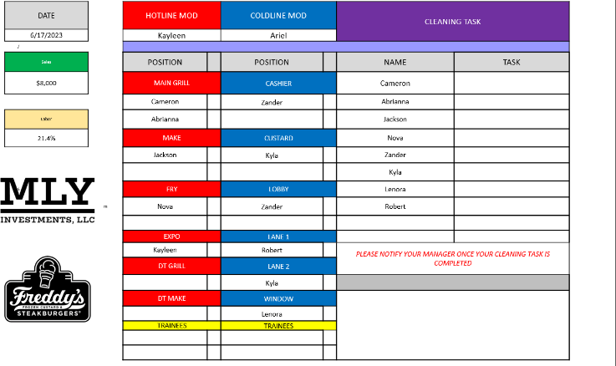
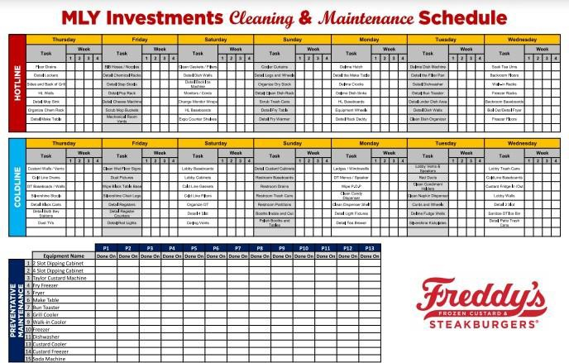
WEEK 1 – DAY 4
This page should be completed by the Training Manager
The Line-Up Board is used to communicate with the team members what positions they are expected to be in throughout their shift. A proper line up will determine how well the execution of your shift will be. It is important to remember to put Aces in Places to make sure our Guests are having the best experience possible. One other thing to note is to make sure your team has an “attack the line” mentality and is prioritizing our Guests over other daily tasks.
Assigning Cleaning Calendar Tasks is an important component to upholding and maintaining the restaurant’s facilities. Cleanliness is one of our 3 pillars and needs to be maintained with utmost importance as a dirty restaurant is not appealing or safe for our Guests. The Cleaning Calendar contains Preventative Maintenance tasks that may not be part of the daily routine but still need to be maintained and never neglected.
Running Custard itself is a simple process. The trickiest part is simply when to run the custard and how much to run. The important motto to remember is to run Less Custard, More Often. This will help make sure that the Guests are always receiving fresh, high-quality product. Custard has a shelf life of 2 hours, and we want to make sure we keep an eye on the clock so we can start making more before the shelf life expires. Some visual indicators of bad product are:
ice crystals starting to form, 2) the color changes to a darker shade, or 3) the custard becomes harder to scoop.
When it is time to make more custard, turn the switch to freeze and turn on the dasher. You will leave the faceplate closed until the custard comes out in a thick very slow-moving ribbon. If the custard is coming out too fast, then you may want to adjust the flow valve on the top of the machine.
Important things to remember when Running Custard:
Make Less, More Often
The Rerun Ratio - 60% Fresh, 40% Rerun,
Breaking the Rerun Cycle
The Shelf Life - 2 Hours
The Visual Indicators of good and bad custard (shiny vs matte)
How to Adjust the Flow to make the highest quality custard
The Recipe for Vanilla Mix
Ensuring "Cold Contact"
How each Switch on the machine works, including where to find the reset switches

Slide 21
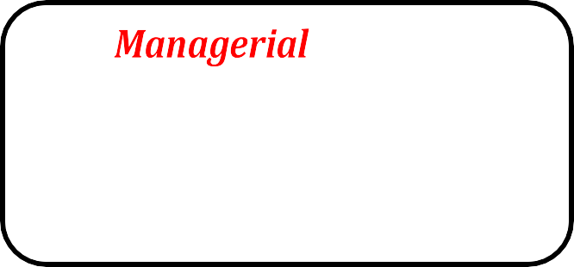
WEEK 1 – DAY 5
This page should be completed by the Training Manager
Training
Daily Sales Summary
Sanitizing the Custard Machine
DSS Tutorial
Daily Drawer Counts (2/5) - Content found on Day 3
Readiness Evaluations (2/4) - Content found on Day 3
Line Up Board (1/2) - Content found on Day 4
Cleaning Calendar Tasks (1/2) - Content found on Day 4
Running Custard (1/5) – Content found on Day 4
Include notes about strengths, opportunities, personal observations, questions, etc.
Notes:
To be completed by the Training Manager or MUM
MIT Workbook Position Objectives (Page 14)
MLY Managerial Training Objectives (Above)
MLY Daily Review Completed (Above)

Slide 22
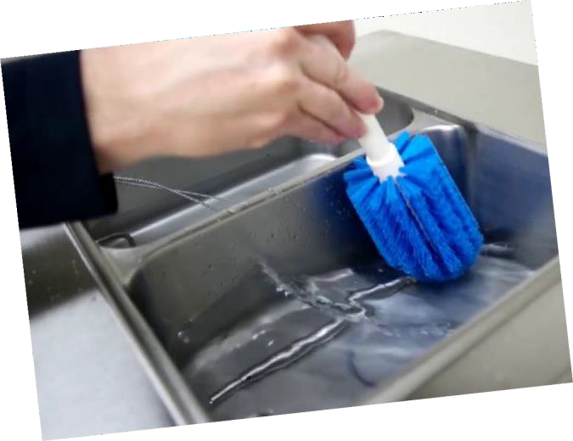
WEEK 1 – DAY 5
This page should be completed by the Training Manager
The Daily Sales Summary helps communicate financial information to the corporate office in a timely manner. The DSS contains information such as verifying the deposit, clock in/outs, comps/voids, and uploading paid out receipts.
Important things an MIT must know include:
The Expectation that the DSS is to be completed by 8:30am each morning
Adjusting the deposit (as needed)
Adjusting team member clock ins/outs (as needed)
How to scan and upload receipts (as needed)
Each morning we must Sanitize the Custard Machine before use to make sure the product we put in does not encounter any bacteria that may have built up overnight.
The Sanitizing Process:
Fill a large bucket with 12 quarts of COLD water.
Add 1 Kay 5 sanitizer packet to the water and whisk until itis mixed in properly.
Verify that the custard machine was put back together properly and that all bolts have been tightened.
Pour 6 quarts of the water/sanitizer mix into each hopper and turn on the dashers.
Let each side run for 5-10 minutes then open the faceplate and
drain the custard back into the bucket.
Allow the custard machine time to air dry (or dry with paper towels) then turn on the refrigeration and add the mix so that you prepared to run custard for the day.
.

Slide 23
WEEK 2 – DAY 6
This page should be completed by the Training Manager
Training
Nightly Report
Waste Logs
Nightly Reporting
Waste Log Tutorial
Daily Drawer Counts (3/5) - Content found on Day 3
Readiness Evaluations (3/4) - Content found on Day 3
Running Custard (2/5) – Content found on Day 4
Line Up Board (2/2) - Content found on Day 4
Cleaning Calendar Tasks (2/2) - Content found on Day 4
Disassemble and Clean Taylor Machine (3/3) – Content found on Day 2
Include notes about strengths, opportunities, personal observations, questions, etc.
Notes:
To be completed by the Training Manager or MUM
MIT Workbook Position Objectives (Page 20)
MLY Managerial Training Objectives (Above)
MLY Daily Review Completed (Above)

Slide 24
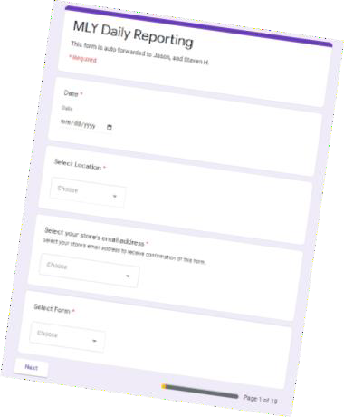
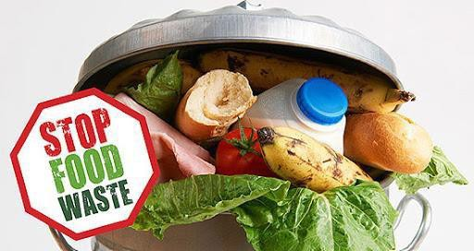
WEEK 2 – DAY 6
This page should be completed by the Training Manager
The nightly report is a form used to communicate all necessary information from the day to the MUM, DOO, and Ownership. It will include information such as your cash over/short, a daily overview, sales and labor projections vs. actual, paid out information, and 14/15 year old labor reports..
The waste log helps us track product waste to identify where we are having issues with managing our food cost. You will be able to see trends in over portioning or any mistakes that resulted in waste.
It is important to track this information so that our Actual vs Theoretical food usage matches up.

Slide 25
WEEK 2 – DAY 7
This page should be completed by the Training Manager
Training
Closing Walk-Through
None
Daily Drawer Counts (4/5) - Content found on Day 3
Readiness Evaluations (4/4) - Content found on Day 3
Nightly Report (1/3) - Content found on Day 6
Waste Logs (1/3) - Content found on Day 6
Running Custard (3/5) – Content found on Day 4
Include notes about strengths, opportunities, personal observations, questions, etc.
Notes:
To be completed by the Training Manager or MUM
MIT Workbook Position Objectives (Page 24)
MLY Managerial Training Objectives (Above)
MLY Daily Review Completed (Above)

Slide 26
WEEK 2 – DAY 6
This page should be completed by the Training Manager
Closing Walk-Throughs are important to ensure the restaurant is properly shut down, cleaned, and secured before leaving. If a proper closing walk-through is not performed it could result in a security hazard that could turn into a crime of opportunity, an equipment safety hazard that could cause a loss or product/fire, or a cleanliness issue that will set back the open and cause the next day to begin behind schedule. The completion of Checklists, adherence to MLY Standards are required, and documentation should occur for not meeting those expectations.

Slide 27
WEEK 2 – DAY 8
This page should be completed by the Training Manager
Training
Google Forms Overview
Mly Manager Portal
Daily Drawer Counts (5/5) - Content found on Day 3
Running Custard (4/5) – Content found on Day 4
Include notes about strengths, opportunities, personal observations, questions, etc.
Notes:
To be completed by the Training Manager or MUM
MIT Workbook Position Objectives (Page 24)
MLY Managerial Training Objectives (Above)
MLY Daily Review Completed (Above)

Slide 28
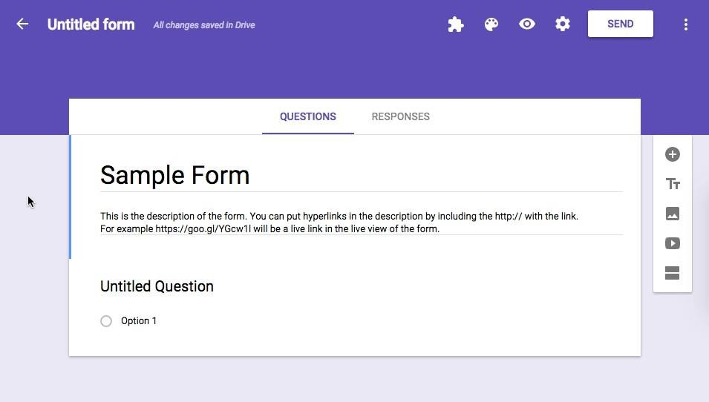
WEEK 2 – DAY 8
This page should be completed by the Training Manager
Throughout your training process, you have been introduced to a few Google Forms used for reporting various information. Today we will cover the remaining forms, and ensure that you are comfortable completing each one:
MLY Daily Reporting
Vacation Request Form
Resignation Form
Termination Checklist
Team Member Interview Form
Team Member IncidentForm
Team Member Performance Evaluation
Wage Increase Request Form
Referral Bonus
Guest Compensation Form
Checklist Completion Rates
Guest Foodborne Illness Form
GM Weekly Report
Hotel Request Forms
Systems Access Request
Corrective Action
Payroll Deductions
Delivery Error Credit Request

Slide 29
WEEK 2 – DAY 9
This page should be completed by the Training Manager
Training
Temp Log
Prep list completion
None
Daily Sales Summary (1/4) - Content found on Day 5
Prep List (1/1) - Content found on Day 5
Running Custard (5/5) – Content found on Day 4
Google Forms (1/1) – Content found on Day 8
Include notes about strengths, opportunities, personal observations, questions, etc.
Notes:
To be completed by the Training Manager or MUM
MIT Workbook Position Objectives (Page 30)
MLY Managerial Training Objectives (Above)
MLY Daily Review Completed (Above)

Slide 30
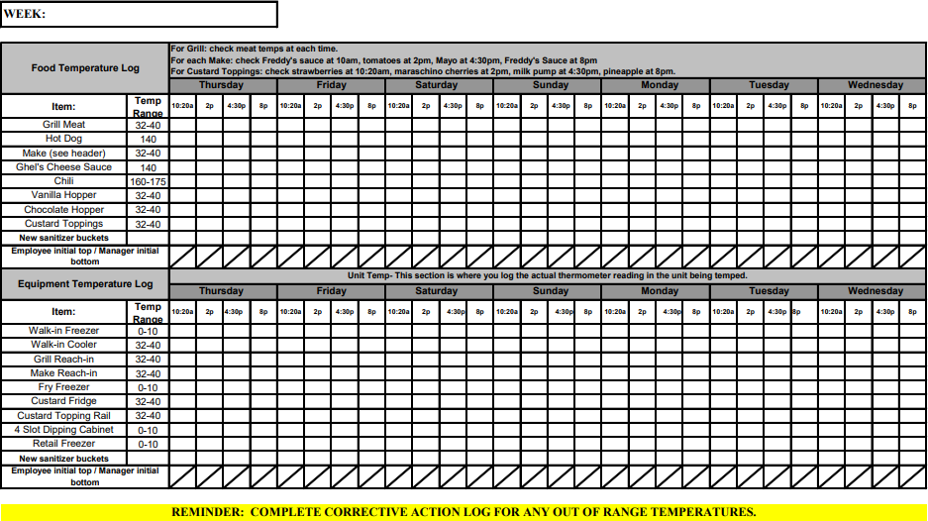
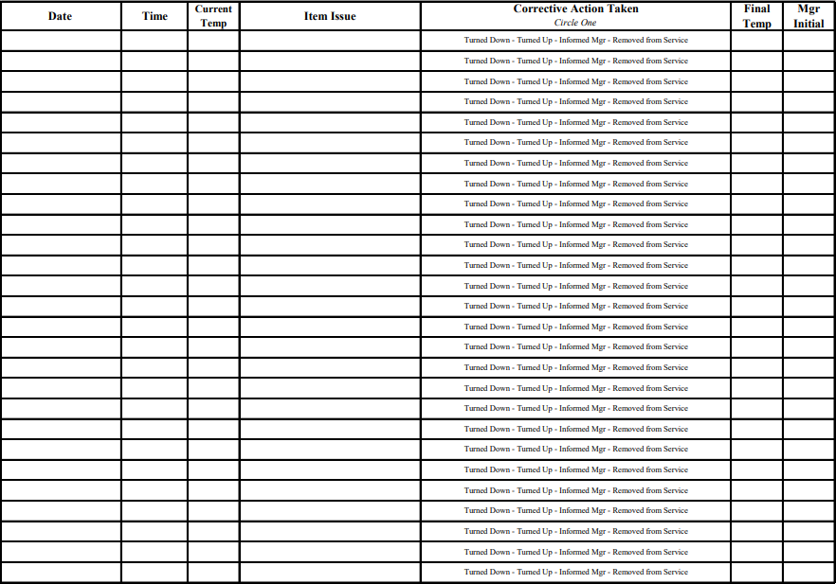
WEEK 2 – DAY 9
This page should be completed by the Training Manager
The Temp Log is completed 4 times a day and is an essential step in providing proper food safety. Taking temps will help you identify if you are having any issues with product or equipment and allow you to react quickly to correct the issue. Additionally, proper temperatures will prevent a foodborne illness outbreak and protect us from liability that results from a foodborne illness complaint.

Slide 31
WEEK 2 – DAY 9
This page should be completed by the Training Manager
HOT LINE SUMMER PREP LIST - USE EVERYDAY
Item Container Temp Build To On Hand Need Initials
LETTUCE/TOMATO/GRILLED O 24 HOUR PREP
Shredded Lettuce | 1/3 Plastic Pan | 32-40 | 6
Lettuce Wraps | 8 Qt Container | 32-40 | 2 Containers
Tomatoes Sliced | 1/3 Plastic Pan | 32-40 | 4
Grilled Onions | 1/3 Plastic Pan | 32-40 | 2
ONIONS 48 HOUR PREP
Sliced Onion Rings | 1/3 Plastic Pan | 32-40 | 5
California Sliced Onions | 1/6 Plastic Pan | 32-40 | 4
Diced Onions | 1/9 Plastic PAN | 32-40 | 2
Peeled Onions | 22 Qt Container | 32-40 | 1
CHEESE/ BACON 4 DAY PREP
American Cheese | Separate log ,1 log = 2 bricks | 32-40 | ALL
Swiss Cheese | Separate log, 1 log = 4 bricks | 32-40 | 4 Double Blocks
Mont.Cheddar Cheese | 1/9 Plastic Pan | 32-40 | 3
Bacon Strips | 1/3 Pan Plastic | 32-40 | 4
Prep lists are one of the checklists we utilize to ensure that we are properly prepared to execute the upcoming day. Prep levels are important to keep us from running out of product and causing an inconvenience to our Guests and team members.
CHICKEN BREAST/ VEGGI 3 DAY PREP
Grill Chicken | 1/6 pan (5 patties per pan) | 32-40 |  | 3
Veggie Burgers | 1/6 pan (5 patties per pan) | 32-40 |  | 2
CONDIMENTS 7 DAY PREP
Ketchup Bottles | Plastic Squeeze Bottle | 32-40 | All
Mustard Bottles | Plastic Squeeze Bottle | 32-40 | All
Freddy Sauce | 1/9 pan | 32-40 | 3
Relish | 1/9 pan | 32-40 | 1
Mayonnaise | 1/9 pan | 32-40 | 1 + 1 BU
Pickle Slices | 1/3 pan metal | 32-40 | 6 Pans
Sport Peppers | 1/9 pan (1/2 Full) | 32-40 | 1 + 1 BU
Jalapenos | 1/6 Pan Portions | 32-40 | 12 Portions
Sauerkraut | 1/6 pan (portions) | 32-40 | 10 Portions
Freddy Fry Sauce | 1/3 pan | 32-40 | 3
Spicy Fry Sauce | 1/3 pan | 32-40 | 2
As important as it is to be prepared, you also want to make sure your prep pars are not too high which could result in a products shelf life expiring thus creating unnecessary waste and driving your Food Cost up!
These should be updated any time there is a new LTO and as needed based on season changes.
FREEZER PREP
Chicken Tenders | Fill Hotel Pan | 0-10 | 4 Pans
Onion Rings | 5.5 oz Portions | 0-10 | 2 pans
Cheese Curds | 5 oz Portions | 0-10 | 4 Pans
Spicy Chicken | Fill 1/3 Pan | 0-10 | 2 Pans
Crispy Chicken | Fill 1/3 Pan | 0-10 | 2 Pans
BREAD PREP
Hot Dog Buns | 12 Quart Container | Room | 4 containers
Rye Bread | 12 Quart Container | Room | 4 containers
Sandwich Bread | 12 Quart Container | Room | 1 Container
LTO PREP
 |  | FRZ

Slide 32
WEEK 2 – DAY 10
This page should be completed by the Training Manager
Training
Instacart/Walmart Orders
Change Orders
Checklist Completion Rates
Instacart/Walmart Tutorial
Change Order Tutorial
Temp Logs (1/1) - Content found on Day 9
Prep list completion (1/1) - Content found on Day 9
Daily Sales Summary (2/4) - Content found on Day 5
Include notes about strengths, opportunities, personal observations, questions, etc.
Notes:
To be completed by the Training Manager or MUM
MIT Workbook Position Objectives (Page 30)
MLY Managerial Training Objectives (Above)
MLY Daily Review Completed (Above)

Slide 33
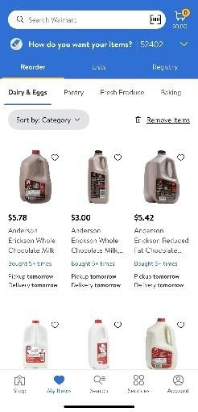
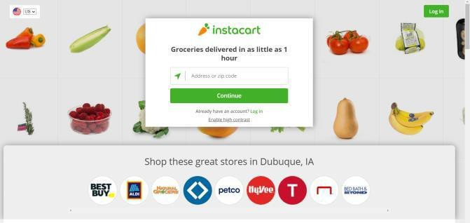
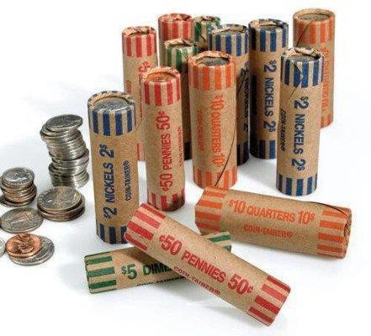
WEEK 2 – DAY 10
This page should be completed by the Training Manager
Instacart/Walmart are both grocery delivery services we use to have local items delivered to the Restaurant. Some examples of local items that we source are milk, bananas, lemons, dish soap etc. The reason we source certain items locally varies but is typically related to product cost, shelf life, or pack size.
This list can be found on OneDrive.
Change Orders are placed weekly so that the Restaurant has Enough $1 bills and coin for all the drawers in the Restaurant. When placing a coin order, we use the extra $10s, $20s, $50’s, And $100s from the petty drawer and determine how much we have to spend.
Next, calculate what we need to order that week totaling the money we have from petty. We then submit that money as a deposit and send it on the Armored Truck. After we have determined what we need for coin, go to mylsb.com, branch location Waterloo – choose Change order request – insert info accordingly and check pre-arranged transport. Please submit all change order request by early Monday.
Remember to always check the coin order in when it is received to prevent any shortages
Checklists are our most common preparation tool to make sure that we are prepared throughout each part of the day. Some of our checklists include the Opening, Own the Zone, Closing, Temp Logs, Manager Open/Close, and the High Traffic Disinfectant checklist. It is important as the manager on duty that you always ensure the completion of these checklists throughout the day. They are, quite simply, the basic building blocks of SUCCESS.

Slide 34
WEEK 3 – DAY 11
This page should be completed by the Training Manager
Training
Brink Functions
Guest Compensation Form
Guest Incident Form
Refund
LEARN TO
None
Running Custard (2/5) - Content found on Day 9
Nightly Reporting (2/3) - Content found on Day 6
Waste Log (2/3) - Content found on Day 6
Closing Walk-Through (2/3) - Content found on Day 6
Include notes about strengths, opportunities, personal observations, questions, etc.
Notes:
To be completed by the Training Manager or MUM
r
MIT Workbook Position Objectives (Page 30)
MLY Managerial Training Objectives (Above)
MLY Daily Review Completed (Above)

Slide 35
WEEK 3 – DAY 11
This page should be completed by the Training Manager
Brink Functions
Brink is the POS, or "Point-of-Sale" software system used to power our terminals. Throughout your training you have learned a
few basic functions. Today we will dive into the remaining functions of Brink that you will encounter on a regular basis.

Slide 36
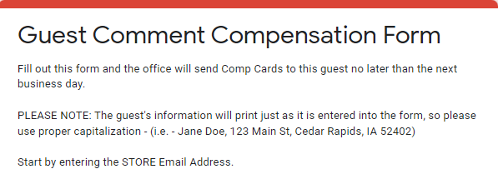
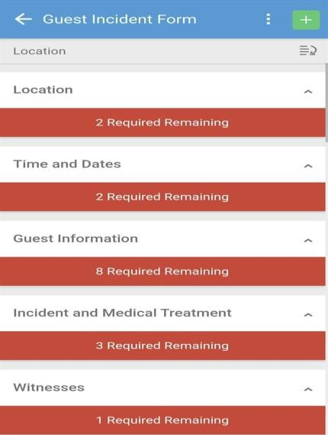
WEEK 3 – DAY 11
This page should be completed by the Training Manager
Guest Compensation forms are our go to resource in handling a guest issue for someone who has already left the store and cannot return the same day. This form allows you to enter the guest’s name, phone number, address, and the amount of comp cards needed (make sure we overcompensate) to be mailed out by Kellie within 3-5 business days.
Guest incident forms are a very important resource located on Zenput for any guest injuries that may occur. This form is to be filled out immediately AFTER making sure the guest has received the proper medical care if needed. The reason we fill out this form is to have all the information such as time/date, guest information, required medical treatment, witness statements, and incident details properly documented to protect us in the case of a lawsuit.
Sometimes when handling a guest issue, we may need to issue a cash refund. Note that the refund should be our last resort as most issues can be resolved by using the L.E.A.R.N. T.O. method. The main other instance where a refund would need to be used would be if a guest was overcharged for items they did not order.
MITs should know how to:
Enter refund mode
Enter the proper amount that needs to be refunded
Fully process the refund

Slide 37
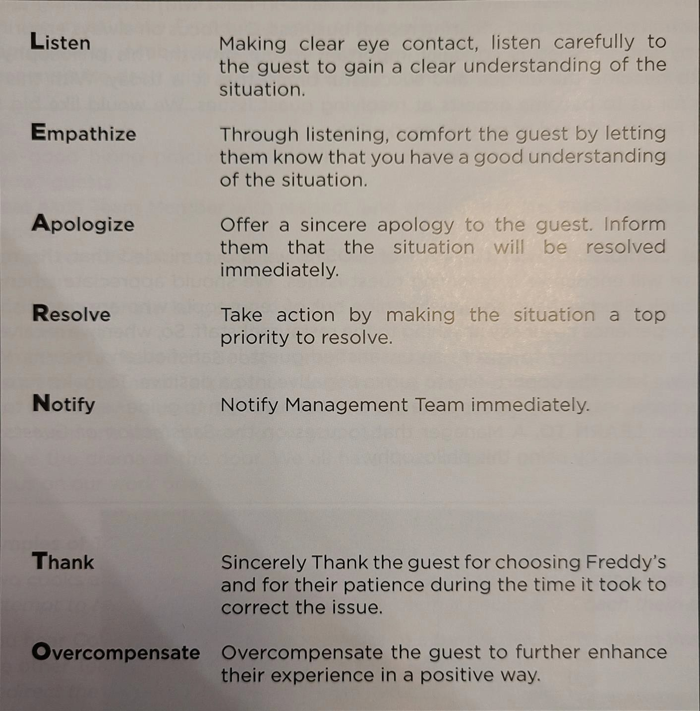
WEEK 3 – DAY 11
This page should be completed by the Training Manager
This is the method that Freddy’s uses when resolving any guest issues. The important thing to understand is even though mistakes happen sometimes, it is our responsibility as a manager to take that negative experience and really “WOW” that guest with that fact that we sincerely care which in turn can take that negative experience back to a positive one very quickly.
Listen
Making clear eye contact, listen carefully to the guest to gain a clear understanding of the situation.
Empathize
Through listening, comfort the guest by letting them know that you have a good understanding of the situation.
Apologize
Offer a sincere apology to the guest. Inform them that the situation will be resolved immediately.
Resolve
Take action by making the situation a top priority to resolve.
Notify
Notify Management Team immediately.
Thank
Sincerely Thank the guest for choosing Freddy’s and for their patience during the time it took to correct the issue.
Overcompensate
Overcompensate the guest to further enhance their experience in a positive way.

Slide 38
WEEK 3 – DAY 12
This page should be completed by the Training Manager
Training
Read Chapter 8
Emergency Action Plans
Safety and Security Protocols
Bodily Fluid Cleanup
None
Nightly Reporting (3/3) - Content found on Day 6
Waste Log (3/3) - Content found on Day 6
Closing Walk-Through (3/3) - Content found on Day 6
Brink Functions (1/1) – Content found on Day 11
Include notes about strengths, opportunities, personal observations, questions, etc.
Notes:
To be completed by the Training Manager or MUM
MIT Workbook Position Objectives (Page 38)
MLY Managerial Training Objectives (Above)
MLY Daily Review Completed (Above)

Slide 39
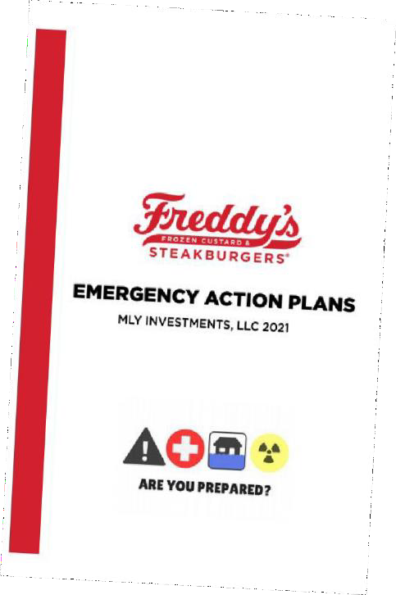
WEEK 3 – DAY 12
This page should be completed by the Training Manager
Within every location is an Emergency Action Plan Booklet that is located by the phone in your office. Inside this booklet, you will find resources on how to handle the following:
Bomb Threat
Criminal Activity
Crisis
Evacuations
Fire
Flood
Tornado
Foodborne Illness
Lockdowns
Medical Emergencies
Power Outages
Suspicious Packages
Terminal Issues
Workplace Violence
Our top priority is the safety and security of our team members, Guests, and vendors. In Chapter 8 of the Management Manual, you will find important information regarding our Safety and Security Protocols
Read Chapter 8
In all locations, you will find a Bodily Fluid Cleanup Jit similar to the one pictured here. Every kit contains specific instructions on how to handle biohazard spills. The following page outlines the instructions found inside
Read the following page on Cleanup Instructions

Slide 40
Clean-up of Vomiting and Diarrheal Events
Close or block off the affected area using signage or a safety cone. Using a commercial biohazard kit, put on
disposable plastic apron, face mask, shoe covers, then put
on disposable gloves.
Sprinkle absorbent material onto the spill and allow it to stand for the time specified by the product label or until the fluid is fully absorbed and jelled. Apply EPA-approved disinfectant to the spill, following label directions and local regulatory agency requirements. Spray area until it is completely covered with the disinfectant solution, in accordance with the product label.
Using a disposable shovel andpaper towels, completely pick up all of theJelled substance. Place it in a heavy-duty trashbag and seal the bag lighUy aocording to your facility's
procedures. Place this bag into a second trashbag {leave open).
Use paper towels and addlttonal disinfectant following label directions to clean up surrounding areas that may have been affected by the spill, including around and under chairs, tables, benches, etc. Place all soiled paper towels into the outer trash bag.
Once more, apply disinfectant to the area, following directions for use on the product label. Allow the product to penetrate and remain wet for the time specified on the product label. Wash, rinse, and sanitize all food contact surfaces in affected area.
Once thorough cleaning and disinfecting is completed, remove the apron and shoe covers and place them into the outer trash bag. Remove gloves and dispose of into outer trash bag.
Seal the bag lightly andplace In the dumpster outside the establishment, having a second employee who is wearing proper gloves open doors and the dumpster to prevent cross­ contamination.
Once the affected area is dry, remove wet floor sign and reopen the area.
ECOLAB
FoodSaft(yfoou.,.com

Slide 41
WEEK 3 – DAY 13
This page should be completed by the Training Manager
Training
Proper Hood Cleaning
HL Preventative Maintenance
Preventative Maintenance Booklet/Cleaning Calendar Sign-off
Include notes about strengths, opportunities, personal observations, questions, etc.
Notes:
To be completed by the Training Manager or MUM
MIT Workbook Position Objectives (Page 38)
MLY Managerial Training Objectives (Above)
MLY Daily Review Completed (Above)

Slide 42
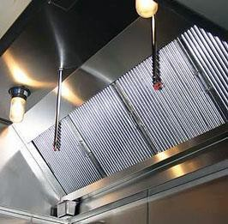
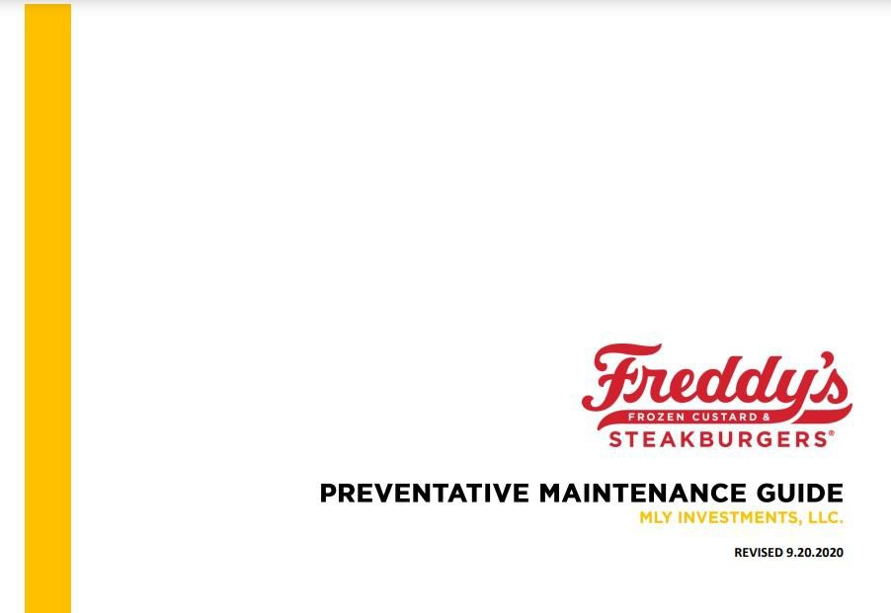
WEEK 3 – DAY 13
This page should be completed by the Training Manager
Proper Hood Cleaning is an important part of our closing routine. While these are maintained professionally on a quarterly basis, we must do our part nightly to ensure our exhaust systems remain in top working condition.
Important components of the close include:
When to remove hood inserts (Auto-Mist Schedule)
How to remove hood inserts properly
Sanitizing the hood inserts
Polishing the interior of the hoods
Monthly detailing procedures
DON’T USE WIRE BRUSHES ON THEHOODS
One of our top controllable expenses each year is maintenance costs. A large majority of maintenance costs could be avoided with proper preventative action. In the Preventative Maintenance Guide, you will find step by step instructions on how to maintain items that are within the scope of Restaurant managers and does not require professional intervention.
Note also that many of these tasks are scheduled on our Cleaning Calendar!

Slide 43
WEEK 3 – DAY 14
This page should be completed by the Training Manager
Training
Freddys Force 4 Good
Dropbox
Upkeep
Remaining Zenput Forms
Zenput Tutorial
UpKeep Tutorial
Daily Sales Summary (3/4) - Content found on Day 5
Google Forms (1/1) - Content found on Day 13
Include notes about strengths, opportunities, personal observations, questions, etc.
Notes:
To be completed by the Training Manager or MUM
MIT Workbook Position Objectives (Page 38 & 48)
MLY Managerial Training Objectives (Above)
MLY Daily Review Completed (Above)

Slide 44
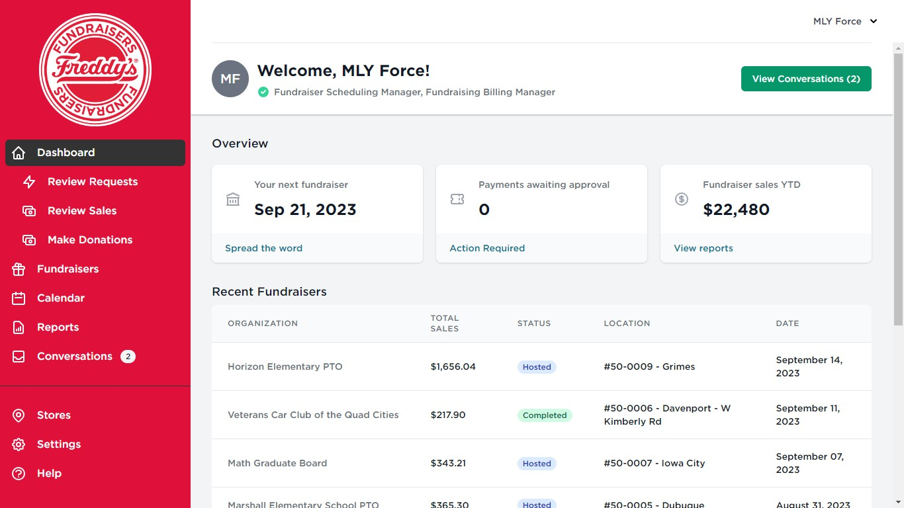
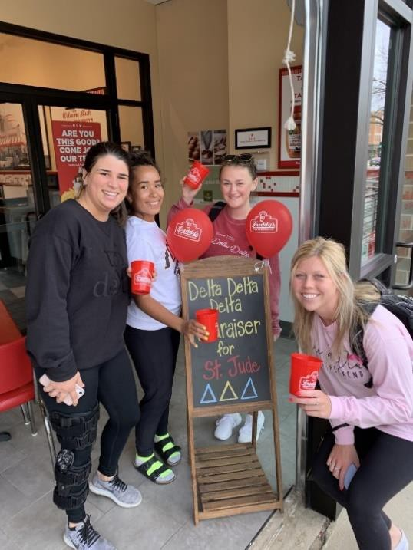
WEEK 3 – DAY 14
This page should be completed by the Training Manager
Freddy’s Force 4 Good is our Fundraising website. This is used for managing and scheduling fundraiser nights. Anytime someone does a fundraiser through Freddy’s they get 15% of the total sales for the business they brought in. The give back button on our POS automatically does the 15% when pressed. Best Practice reminder is to make it a “big deal” & always allow the guest to tell you if they are here for the fundraiser.

Slide 45
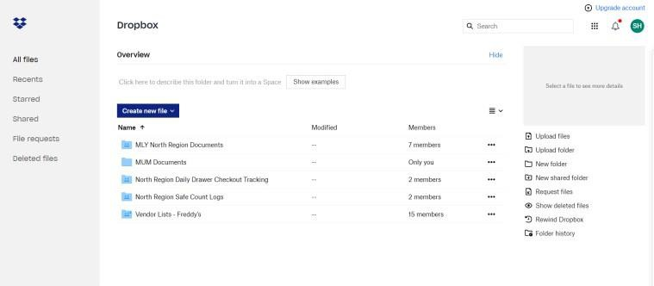
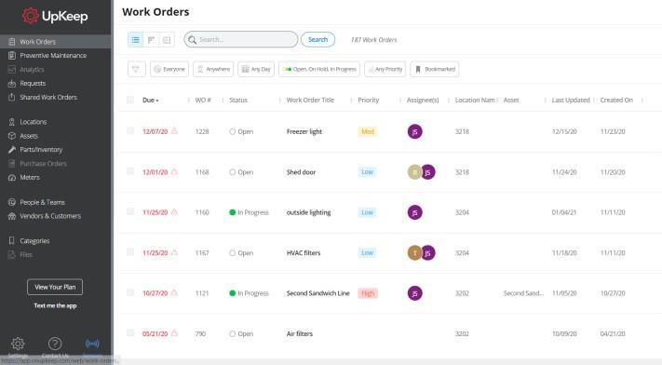
WEEK 3 – DAY 14
This page should be completed by the Training Manager
To stay organized we use an online system called Dropbox to share files with other locations and between Restaurants and regional leaders.
Some examples of forms shared would be:
Daily Drawer Counts
Contact Lists
Delegation Lists
Etc.
UpKeep is how Restaurants request service on items that need repaired in the Restaurant. Once submitted, these requests go directly to the Facilities Manager who in turn creates a work order for the task at hand. In most cases you will be contact within 24 hours for Medium to High severity issues.
Important things to cover include how to:
Submit a request
Add Notes to a request
Cancel a request
Check the Status of a submission
Throughout your training you’ve been introduced to a variety of Zenput Forms. Today we will cover the remaining forms you may or may not have been taught that are used by Restaurant managers.
AM/Pm Readiness
Ecosure Audit
Facilities and Equipment Audit
Freddys Factor Audit
Freddys Product Issue Form
Guest Incident Form
Hospitality Audit DT/Dine in
Landscaping Audit
Mystery Shop Report DT/ Dine in
MLY OAR
Manager Closing Audit
Vendor Sign IN / OUT
Guest Incident Form

Slide 46
WEEK 3 – DAY 15
This page should be completed by the Training Manager
Training
❑
Ordering
None
Marketing Expo
Office Express
Spectrum
Hockenbergs
Daily Sales Summary (4/4) - Content found on Day 5
Include notes about strengths, opportunities, personal observations, questions, etc.
Notes:
To be completed by the Training Manager or MUM
MIT Workbook Position Objectives (Page 54)
MLY Managerial Training Objectives (Above)
MLY Daily Review Completed (Above)

Slide 47
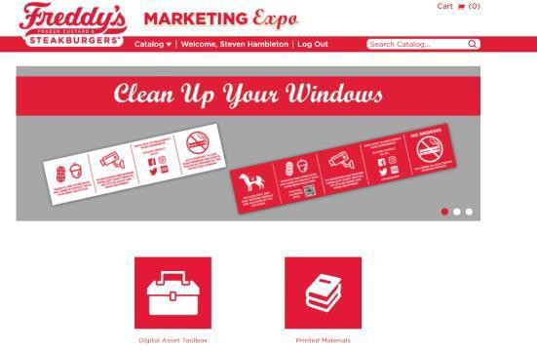
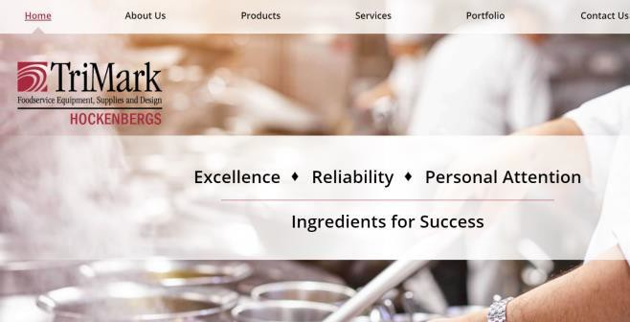
WEEK 3 – DAY 15
This page should be completed by the Training Manager
Here you will find all things Freddy’s Gear. These items are typically ordered once per period and payroll deducted from those that order items
Additionally, you can review Sanmar.com for any custom gear. These purchases must be submitted to the DOO for review and approval prior to purchasing.
Every good operation needs a paper clip or two. Office Express is where you will order anything office related. Paper, paper clips, printer ink, clipboards, etc. are just a few items you may order here from time to time.
There are many signs and posters throughout the Restaurant ranging from information, decorative, to advertising.
This site is where you will order all materials related to printing Freddy’s materials
This site is where you will purchase a majority of your smallware items. Spatulas, grill scrapers, hoses, racks, shelves, containers, etc. are examples of items you may purchase from here.

Slide 48
MANAGERIAL TRAINING
MLY DEVELOPMENT WORKBOOK
The following material is aligned with the Freddy’s USA Managerial training program of the MIT Workbook. Please use all subsequent pages with pages 53 through 82 of the MIT Workbook.

Slide 49
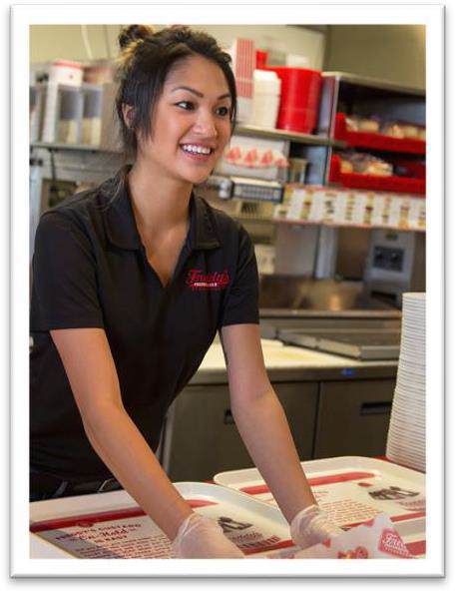
MOD HotLine Lead 1-2-3-4-5
HotLine Priorities
Are there any Food Safety issues?
Is GPS being maintained?
Are all quality control points being maintained?
Is the line running smoothly? (Is your presence needed on the line?)
Start at Grill 1 and work your way down the line
No Red / Yellow Tickets?
Everyone organized
No bottlenecking
Is everything stocked?
Red baskets
Meats
Other products
If Grill, Make and Fry are covered and Guests are being attended to on expo, check the ColdLine.
*If ColdLIne requests help at any time, we will of course move to assist them.
Ways to help ColdLine during smooth operations without interfering with the main positions
Wipe Down Tables / Sweep Dining Room
Table Touch Guests
Change Trash
Stock Drive Thru / Custard
Check Patio Restrooms
Wash Custard Collars
Run more Custard
Clean Blender
Does ColdLine need operational help? Are there Yellow and Red Tickets?
Once these steps have been completed, return to the back of house to repeat 1-2-3-4-5
Remember:
Don’t get stuck in a position for long periods of time, just long enough to help the team out of a jam.

Slide 50
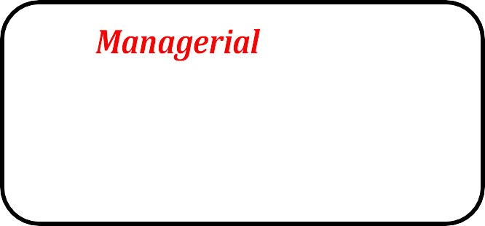
WEEK 4 – DAY 16
This page should be completed by the Training Manager
Training
Closing the Restaurant
Completing effective figure 8s
Adjusting for Food and Labor
Handbook Polices
Mission, Vision & Goal
None
Include notes about strengths, opportunities, personal observations, questions, etc.
Notes:
To be completed by the Training Manager or MUM
MIT Workbook Position Objectives (Page 62)
MOD Activity (Page 62)
MLY Daily Review Completed (Above)

Slide 51
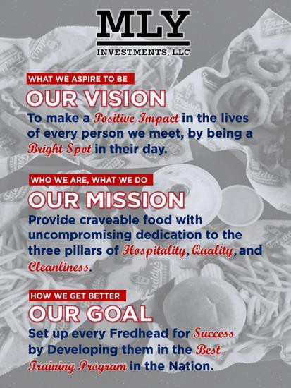
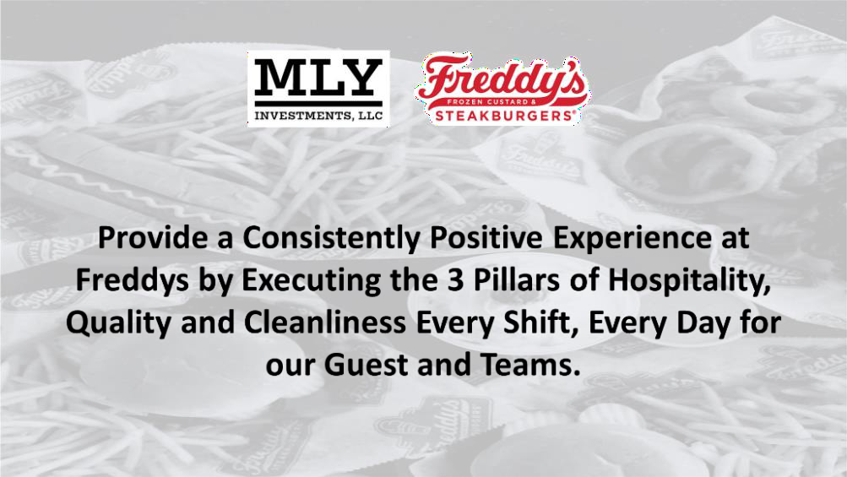
WEEK 4 – DAY 16
This page should be completed by the Training Manager
It is important to understand what MLY’s Mission, Vision, and Goals are so that you are prepared to help us achieve those objectives. These ideals are a direct representation of our beliefs and are realized through each leader in the company.

Slide 52
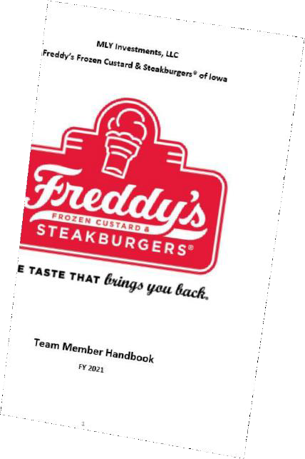
WEEK 4 – DAY 16
This page should be completed by the Training Manager
Throughout your positional training, you have been taught various components of closing the restaurant. Today begins the day that you will apply what you have learned and will effectively LEAD the close of the restaurant without sacrificing the Guest Experience.
Important components of the Close include:
Closing Manager Checklist
Waste Logs
Drawer Counts
Custard Machine Dissemble and Cleaning
Nightly Reports
Maintain the Guest Experience through the Pre-Close
Safety and Security Measures
The MLY Team Member and Manager Handbook is the foundation for which we base all our important policies and procedures. It is important for you to be aware of this information so you can always uphold the highest standards.
As the MOD, you are responsible for maintaining effective Figure 8’s to maintain awareness of the entire restaurant. Getting locked into position will prevent you from being able to adequate support the entire or protect the Guest experience.
Reference HotLine Lead Insert after page 54.
The MOD is responsible for maintaining constant awareness of the “Big 3” controllable items that affect your Restaurants profitability. Each shift you should be aware of where your Restaurant stands against your daily budget and periodic budget.
Awareness of Budgets - Sales & Labor Projections
Labor Controls
Making cuts after volume periods
Proactively adjusting due to Weather or Local Events
Food / Paper Controls
Monitoring waste
Over portioning
Carelessness
Improper procedures
30-Second Coaching Opportunities

Slide 53
WEEK 4 – DAY 17
This page should be completed by the Training Manager
Training
AvT
None
Closing the Restaurant (1/3) - Content found on Day 16
Floating vs. getting locked in positions (1/1) - Content found on Day 16
Completing effective figure 8s (1/3) - Content found on Day 16
Adjusting for Food and Labor (1/5) - Content found on Day 16
Handbook Polices (1/1) - Content found on Day 16
Include notes about strengths, opportunities, personal observations, questions, etc.
Notes:
To be completed by the Training Manager or MUM
MLY Managerial Training (Above)
MLY Daily Review Completed (Above)

Slide 54
WEEK 4 – DAY 17
This page should be completed by the Training Manager
AvT Analysis
AvT stands for Actual vs Theoretical Analysis which uses data gathered from the POS Systems, Truck Orders, and Inventory Counts to determine the amount of product that we theoretically should have used compared to the amount of product we actually used. The difference between these two numbers is called a variance. Our company goal is to have a total variance of 1% or less. The lower your total variance is, shows that you are tracking waste properly, portioning properly, and items are being rang in correctly. If you were to have a high variance it could be due to not tracking waste, miscounting product, over portioning, or even theft. The GM will review this report every Thursday morning as part of their weekly responsibilities.

Slide 55
WEEK 4 – DAY 18
This page should be completed by the Training Manager
Training
None
None
Completing effective figure 8s (2/3) - Content found on Day 16
Adjusting for Food and Labor (2/5) - Content found on Day 16
Include notes about strengths, opportunities, personal observations, questions, etc.
Notes:

Slide 56
WEEK 4 – DAY 19
This page should be completed by the Training Manager
Training
Opening the Restaurant
Scoop
R365
Development Documents (FTSS, S2SR, etc.)
Scoop Tutorial
Completing effective figure 8s (2/3) - Content found on Day 16
Adjusting for Food and Labor (2/5) - Content found on Day 16
Include notes about strengths, opportunities, personal observations, questions, etc.
Notes:
To be completed by the Training Manager or MUM
MLY Managerial Training (Above)
MLY Daily Review Completed (Above)

Slide 57
WEEK 4 – DAY 19
This page should be completed by the Training Manager
Throughout your positional training, you have been taught various components of opening the restaurant. Today begins the day that you will apply what you have learned and will effectively lead the open of the restaurant.
Tasks that you will learn include how to:
Complete the Daily Sales Summary
Enter Drawer Counts
Complete The Opening Manager Checklist
Follow Proper Prep Procedures
Complete the Line-Up Board
Complete AM/PM Readiness
The Scoop is your one stop shop for just about any information Freddy’s
related. You can find the latest news, training videos, and operational files.
Important things to cover include:
MLY Expectation
How to Add and Remove team members
Running Completion Reports
Navigating the Scoop
You are likely already familiar with Restaurant 365, which is utilized for a multitude of tasks within the restaurant. For managing labor, it is utilized for schedule creation and maintenance, availabilities, time off requests, and sales forecast. There are also several administrative and accounting duties that require using R365, such as approving invoices and viewing your Budget Tracker. Additionally, R365 is also used for Food Cost control items such as Inventories and Waste Logs.
Tasks that you will learn include how to:
Add and Remove teammembers
Enter a Sales Forecast
Enter a Schedule (More in Days Ahead)
View, read, and deep dive in the BudgetTracker
Enter Waste Logs
View, read, and Approve Invoices (if applicable)

Slide 58
WEEK 4 – DAY 19
This page should be completed by the Training Manager
These programs detail the advancement opportunities every member of the Freddy’s Family has the opportunity to pursue. Each document outlines the requirements and characteristics that are needed to take that next step in your development.
The Fast-Track Shift Supervisor program is utilized for high performing team members that have been identified as potential management candidates. This program will immerse them in high level areas of the training program and give them exposure to management responsibilities and situations.
The Shift to Senior Shift Program is a program designed for high performing shift supervisors that are interested in pursuing a salaried management position but lack the proper experience to be directly promoted to a salaried manager. This program will give them additional responsibility, real-world experience, and training to prepare them for the next step in their development
The Shift to Salaried Program is a program designed for high performing shift supervisors and senior shift supervisors that are ready to be developed to become a salaried manager. This program will give them additional responsibility, real-world experience, and training to prepare them for the next step intheir development

Slide 59
WEEK 4 – DAY 20
This page should be completed by the Training Manager
Training
Child Labor Laws
None
Opening the Restaurant (1/3) - Content found on Day 19
Scoop (1/2) - Content found on Day 19
R365 (1/1) - Content found on Day 19
Include notes about strengths, opportunities, personal observations, questions, etc.
Notes:
To be completed by the Training Manager or MUM
MLY Managerial Training (Above)
MLY Daily Review Completed (Above)

Slide 60
14 / 15-year-olds MUST take a FULL 30 MIN break for shifts 5 hours or more

Slide 61
MOD ColdLine Lead 1-2-3-4-5
ColdLine Priorities
Are there any Food Safety issues?
Has the Dining Room been attended to?
Table Touches
Guest issues
Table wipe downs
Floor sweeps
Trash
Patio
Restrooms
Is Drive-Thru executing well?
Is your presence needed at the Cashier Position?
Are you needing to assist the Custard Position?
If Cashier, Custard, and Drive-Thru are covered and the dining room has been tended to, check on the Hotline
*If HotLine requests help at any time, we will of course move to assist them.
Does HotLine need operational help? (Yellow and Red Tickets?) If so, ask the HotLine Manager where you are most needed.
Ways to help HotLine during smooth operations without interfering with the main positions
Stock trays or baskets
Replacing backups or bread racks
Refilling meat pan for grill cook
Helping portion fired items
Dropping buns
Helping Expo stage orders
Helping line-sweep and a wipe down
Once these steps have been completed, return to the front of house to repeat 1-2-3-4-5 process.
Remember:
Don’t get stuck in a position for long
periods of time, just long enough to help the team out of a jam.

Slide 62
WEEK 5 – DAY 21
This page should be completed by the Training Manager
Training
Scam Call Procedures
Chain of Command
Disciplinary Action Procedures
Scam Call Procedures
None
Closing the Restaurant (2/3) - Content found on Day 16
Scoop (2/2) -Content found on Day 19
Scheduling (1/1) - Content found on Day 20
Include notes about strengths, opportunities, personal observations, questions, etc.
Notes:
To be completed by the Training Manager or MUM
MLY Managerial Training (Above)
MLY Daily Review Completed (Above)

Slide 63
WEEK 4 – DAY 21
This page should be completed by the Training Manager
At Freddy’s of Iowa, we are professionals, and we act like it.
Like most businesses we have what is referred to as the “Chain of Command.” The Chain of Command is the support system we have in place to handle various issues. The Chain of Command should always be followed so everyone is always kept in the loop. For example, you should always approach your direct supervisor first before contacting their superior. It is the primary responsibility of your direct supervisor to support, resolve, and coach you through any problem that may arise.
Note that if you are unable to reach your immediate supervisor or are uncomfortable doing so, please reach out to the next level supervisor. Each level of leadership is trained to inform those in the chain of command that need to know any pertinent information. Rest assured that if a message should need to reach your Regional Manager, by telling your Supervisor it will.
Handling disciplinary actions correctly is extremely important for not only accountability but to protect the company from potential legality issues.
In this area we will cover:
How to fill out a Disciplinary Action Form
The different types of documentation (Warning, Written Warning, etc.)
Best Practices for properly delivering a DAF
How to handle various situations such as attendance, cash issues, and uniform violations
The importance of Witnesses during all DAF meetings with an employee

Slide 64
WEEK 5 – DAY 21
This page should be completed by the Training Manager
BEWARE OF SCAMS
No Freddy’s corporate personnel (including Scott Redler, Ben Simon, Zach Woodburn, VPs,
Directors, FBCs, etc.) will ever ask any Freddy’s Team Member or Member of Management to do the
following over the phone or email:
Remove money from the safe outside of your company’s standard deposit procedures.
Transfer any funds to any kind of card or account.
Ask for account numbers or account details.
Ask for any kind of password or credentials.
Ask you not to talk to others in management about an incident.
Threaten to terminate or arrest you for not taking an action.
If you suspect you may be the victim of a scam because someone (whose name you recognize
from within the organization) is calling or emailing the restaurant trying to do any of the above or any other suspicious behavior:
Hang up / Don’t reply to the email.
Call your General Manager and/or MUM and report the incident.
Record the incident using your standard reporting or communication tool (TEAMS)
Return to serving guests and managing the restaurant.
For the latest information on current scams, visit The Scoop.

Slide 65
WEEK 6 – DAY 21
This page should be completed by the Training Manager
Training
Watch GHS Video
https://www.youtube.com
/watch?v=RvQNf1Y7E84
Closing the Restaurant (3/3) - Content found on Day 16
Include notes about strengths, opportunities, personal observations, questions, etc.
Notes:
To be completed by the Training Manager or MUM
MLY Managerial Training (Above)
MLY Daily Review Completed (Above)

Slide 66
GHS ACKNOWLEDGEMENT
I , confirm that I have been trained about (1) how to identify Hazardous Chemicals, (2) how to read and understand product warning labels and Safety Data Sheets and where they are located, and (3) how to properly handle and use the chemicals that I am exposed to. I am also confirming that I know the Safety Data Sheet Manual and the Safety Data Sheets are available for reading and referencing at any time. The Safety Data Sheet Manual and Safety Data Sheets are located near the chemical storage rack.
If I have any questions regarding this, I have had them answered by manager before signing this form.
Employee Signature
Date

Slide 67
WEEK 5 – DAY 23
This page should be completed by the Training Manager
Training
Delegations
None
Certification Checklist
Review any topics rated as a 1 or 2
Include notes about strengths, opportunities, personal observations, questions, etc.
Notes:
To be completed by the Training Manager or MUM
MLY Managerial Training (Above)
MLY Daily Review Completed (Above)

Slide 68
WEEK 5 – DAY 23
This page should be completed by the Training Manager
Delegations are the basic responsibilities that ensure the Restaurant is maintaining all aspects of daily operations. Each manager is assigned different delegations to divide and concur all the different responsibilities there are in a Restaurant. The GM is the one responsible for assigning and following up with the rest of the management team to ensure everything is completed properly and in a timely manner.
Note that some Restaurants may add unique delegations depending on the goals set by the GM or MUM. For a full list of Manager Delegations, review the file on Dropbox.

Slide 69
WEEK 5 – DAY 24
This page should be completed by the Training Manager
Training
Management Manual Review
None
Opening the Restaurant (2/3) - Content found on Day 19
Certification Checklist
Review any topics rated as a 1 or 2
Include notes about strengths, opportunities, personal observations, questions, etc.
Notes:
To be completed by the Training Manager or MUM
MLY Managerial Training (Above)
MLY Daily Review Completed (Above)

Slide 70
WEEK 5 – DAY 25
This page should be completed by the Training Manager
Training
Complete Management Exam
Passed or Enrolled in ServSafe
Bonus Plan
Dropbox- Bonus Plan
Opening the Restaurant (3/3) - Content found on Day 19
Certification Checklist
Review any topics rated as a 1 or 2
Include notes about strengths, opportunities, personal observations, questions, etc.
Notes:
To be completed by the Training Manager or MUM
MLY Managerial Training (Above)
MLY Daily Review Completed (Above)

Slide 71
MLY MANAGEMENT BONUS PLAN
At MLY Investments, we believe that our managers should be rewarded for their ability to grow sales and profit while building long-term loyalty with our Guests. Those managers who exemplify “The Freddy’s Way” with an exceptional record of Cleanliness, Friendliness, Fast Service, Food Safety, Workplace Safety, and Fun Work Environments are rewarded for their efforts periodically and quarterly. Full details and qualifications of the bonus plan will be outlined by your General Manager in your home Restaurant.

Slide 72
END OF TRAINING MEETING
This page contains the recap of the MITs greatest strengths and opportunities as well as training that will be needed in their home Restaurant.
 | Behaviors/Actions to Consider: Do they effectively and consistently use tools and systems, showing working knowledge of P&L budget and actual figures? Are they constantly working to control Food, Paper and Labor Cost on a Shift-to-Shift basis? Do they exhibit sales building and cost controlling behaviors, actively seeking to learn more about the business? Do they act like a manager that works ON the business, not IN the business?
 | Behaviors/Actions to Consider: Do they execute all components of a Servant Leader and can results be shown from their efforts? Do they set the standard and lead by example in all areas of management? Do they "run it like they own it" and create the Freddy's Culture at all times? Do they Follow Up and Follow Through with their teams and hold themselves and others accountable at all times?
 | Behaviors/Actions to Consider: How quickly is their accomplishment of store delegations, and is there assumption of additional responsibility, demonstrated commitment through team work? Do they offer feedback and bring solutions to problems? Are they able to complete tasks within appropriate time. Do they use tools and systems effectively as reflected by reviews and audit scores, etc.? Do they communicate their progress on Action Plans? Are they able to operate with minimal supervision?
 | Behaviors/Actions to Consider: Does the Manager conduct effective figure-8’s and shift routines, create proper deployment charts, complete checklists, Cleaning Calendar and miscellaneous Action Plans? Do they communicate well with fellow managers and team, are they comfortable operating a shift solo and are they effective in Open, Mid and Close shift? Do they enforce Food Safety Policies?

Slide 73
END OF TRAINING MEETING
This page contains the recap of the MITs greatest strengths and opportunities as well as training that will be needed in their home Restaurant.
 | Behaviors/Actions to Consider: Can they effectively diagnose a problem and formulate an effective action plan? Do they effectively identify, determine, solve and correct problems as they arise? Do they go out of their way to discover and solve problems proactively?
 | Behaviors/Actions to Consider: Does their behavior Increase sales and transaction growth (year over year)? Are Mystery Shopper scores and guest comments positive during their shifts? Are they able to handle upset guests and move throughout the lobby? Do they build Guest Relationships beyond a simple table touch?
 | Behaviors/Actions to Consider: Does the manager conduct Pre-Shifts, participate in MIT/Team Member Training, engage in 30-Second Coaching Opportunities? Does the manager effectively use opening/closing checklist, engage in open dialog with fellow managers, encourage direction and communication with team during shifts? Are they active in Manager Log communications and sharing current policies and procedures with team members, are they attentive and participate in meetings? Do they communicate effectively with superiors and respond to emails on a timely basis?
 | Behaviors/Actions to Consider: Do they contribute to high Retention through the 3 R's? Do they have respect for others and motivate their team? Are they professional, establishing rapport between management and team members? Are they known for creating the Freddy’s Culture by how they interact with others? Do they show commitment to Freducation and Learning Zen, Trainee Schedule and Courses? Are certified trainers in place developed and held accountable? Do their efforts show success in developing team members, shift supervisors and assistant managers as demonstrated through their promotional advancement and ability to take on tasks?

Slide 74
END OF TRAINING MEETING
This page contains the recap of the MITs greatest strengths and opportunities as well as training that will be needed in their home Restaurant.
STRENGTHS
COMMENTS
OPPORTUNITIES
COMMENTS
HOME STORE TRAINING
COMMENTS
MIT Signature:
TRAINING MGR Signature:

Slide 75
Welcome to the Leadership Team!

